Slide 1

Real Estate Price Predictor - deployment
Klebert, Preeti, Sofia, Yves

Slide 2
Deployment strategy
Modular Architecture
Containerization
Modular two-layer design:
Backend: FastAPI REST API serving ML predictions (two endpoints: full features / top 30).
Frontend: Streamlit-based UI enabling user interaction
This separation allowed independent development, testing (e.g., with Postman)
Both the frontend and backend were
- fully containerized using Docker
- deployed as isolated services
This enabled us to:
Standardize builds across environments (local and cloud)
Simplify testing and versioning
Deployment on Render
Deployment on Azure (benefits over Render)
2 Web services deployed using Render:
API
Streamlit – UI
Limited functionality on free version (API error 429 Too Many requests)
Better control over environment variables, logs, and startup behavior
Built-in monitoring via Azure Monitor and Application Insights.
Stable and scalable infrastructure, with support for production-grade workloads
Azure Container Registry (ACR) to host Docker images securely.
Notes:
Slide – Deployment Strategy (Short Talk)
We adopted a modular two-layer design:
A FastAPI backend serving two prediction endpoints.
A Streamlit-based frontend for user interaction.
This allowed independent development and testing, e.g., with Postman.
We containerized both services with Docker, deployed them separately, and ensured consistent builds across environments. This helped with versioning, testing, and parity between dev, staging, and production.
For deployment, we chose Azure for its enterprise-grade flexibility:
We used Azure App Service for both frontend and backend,
and ACR to securely host Docker images.
Compared to Render, Azure gives us better control over startup behavior, environment variables, and logs, along with built-in monitoring tools and scalable infrastructure.

Slide 3
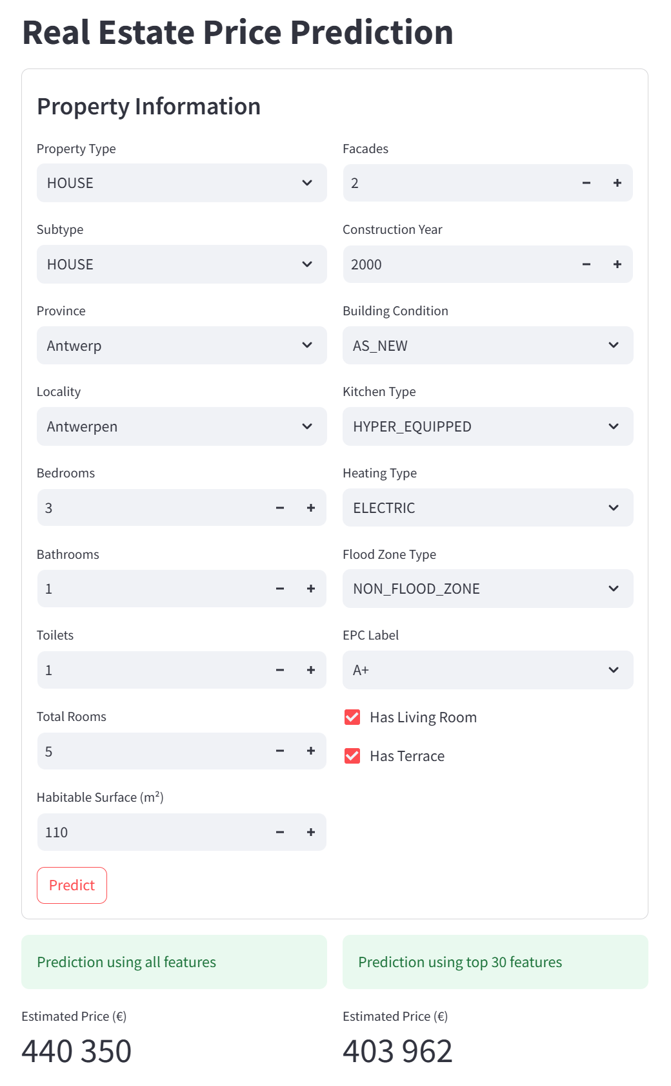
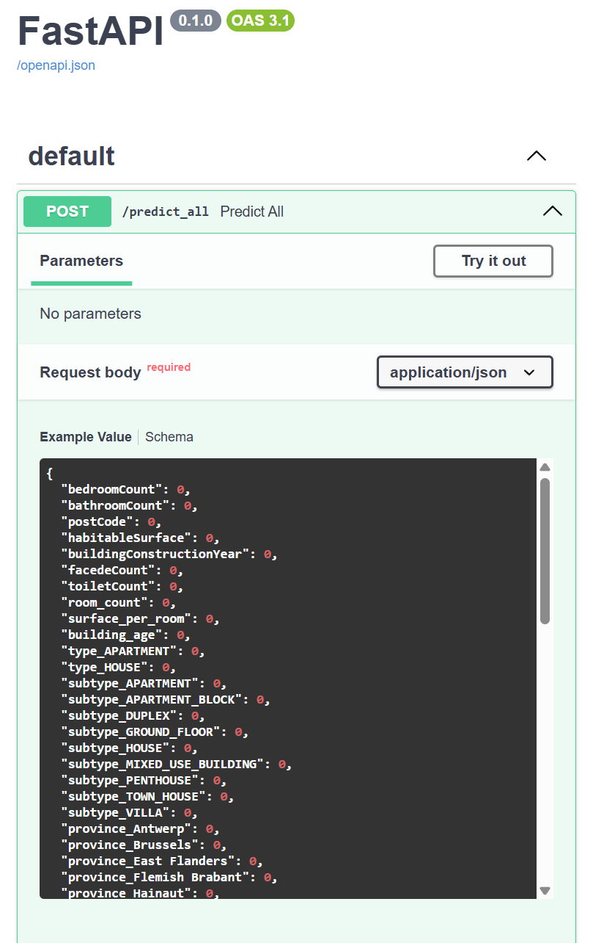
Demo
Frontend
https://realestate-ui.azurewebsites.net/
Backend
https://realestate-api.azurewebsites.net/docs

Slide 4
Challenges
Misunderstanding
When creating the containers in render,
not understanding that 2 containers had to be created
One for the API and one for the price predictor mode
→ this meant that I created one container with all my files, and later had to separate them

Slide 5
Limits & Next Steps
Why Streamlit Isn’t Enough for Production-Grade Apps ?
Streamlit is great for quick results, but
Use React, Angular, Vue instead
Not ideal for complex apps (no routing, no advanced state management).
Full client-side routing (e.g., React Router), global state management (Redux, Vuex, NgRx…)
Poor support for custom UI/UX or mobile responsiveness
Full control over layout, animations, themes, and responsive design (CSS, Tailwind, Material UI…)
Basic security ! No enterprise IAM or fine-grained access control
Secure auth integration (OAuth2, Firebase, Azure AD, Auth0) with fine-grained access control
Notes:
Streamlit is great for prototyping, but it doesn't scale well for complex production apps.
Here’s why we may moveto frameworks like React:
Streamlit has no routing and lacks advanced state management. With React or Angular, we get client-side routing and global state control using tools like Redux.
Streamlit is limited in UI flexibility and mobile responsiveness. In React, we can fully customize the design with CSS, Tailwind, and animations.
Security is very basic on Streamlit — no enterprise-grade access control. Modern frameworks integrate with OAuth2, Firebase, or Azure AD, enabling fine-grained user access.

Slide 6

Cloud deployment
Our deployment strategy moved from Render to Azure to enable better control, automation
Challenges: limitations of Render
Advantage (Azure / AWS / GCP)
Limited control over container configuration and environment variables
Full control over startup commands, port binding, environment variables, and scaling options
Cold starts and inconsistent performance on the free tier
Consistent runtime performance with autoscaling and production-grade plans
No scripting unlike Azure CLI, AWS CLI, or Google Cloud SDK
Full scripting support for repeatable, automated deployments via CLI and IaC (e.g., Bicep, Terraform)
Repeatable, scripted deployments difficult to implement
No integrated monitoring or diagnostics tools,
Built-in tools like Azure Monitor, Application Insights, CloudWatch, and Stackdriver for observability and debugging
Debugging is difficult
Notes:
We moved from Render to Azure to gain more control, automation, and observability.
Here's a summary of the main reasons:
Render offers limited control over container startup, ports, and environment variables.
Azure provides full control over these aspects.
We experienced cold starts and inconsistent performance on Render.
Azure ensures stable performance with autoscaling and production-grade plans.
Render lacks scripting tools for automated deployments.
Azure supports full automation via CLI and Infrastructure as Code tools like Bicep and Terraform.
Render does not offer integrated monitoring or diagnostics. Azure includes tools like Monitor and Application Insights for observability and debugging.

Slide 7
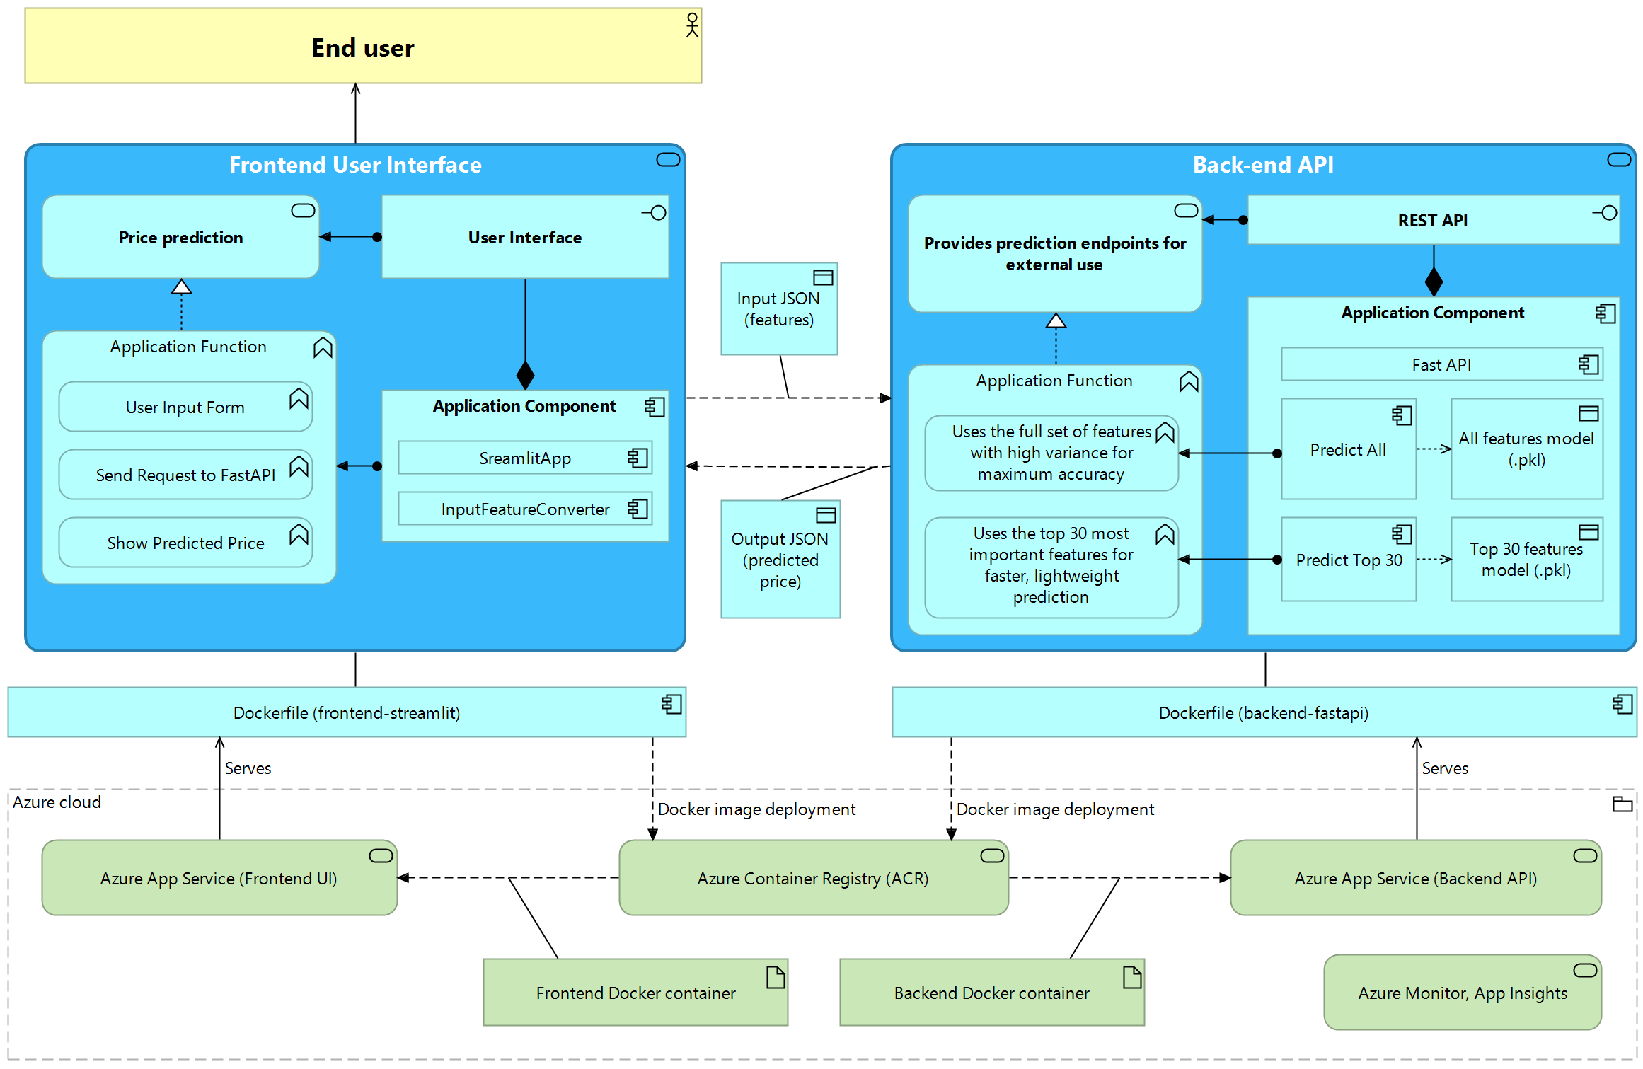
Real Estate App Deployment with Docker & Azure Services
Notes:
Slide – Real Estate App Deployment (Talk)
This diagram shows our end-to-end architecture for deploying the real estate price prediction app using Docker and Azure services.
We designed the system with two separate components:
1. Frontend – Streamlit UI
The user interacts with a simple interface to input property details.
These inputs are processed by the InputFeatureConverter, then passed as JSON to the backend API.
After receiving the predicted price, the result is displayed to the user.
2. Backend – FastAPI
The backend exposes a REST API with two endpoints:
Predict All: uses all features for maximum accuracy.
Predict Top 30: uses only the 30 most important features for a faster, lightweight prediction.
Both endpoints load the appropriate .pkl models and return the prediction as JSON.
3. Containerization & Azure Deployment
We built separate Docker images for the frontend and backend.
These images are pushed to Azure Container Registry (ACR).
They are then deployed to Azure App Service — one for the frontend UI, one for the backend API.
We use Azure Monitor and Application Insights for observability and diagnostics.
This setup ensures modularity, scalability, and traceability, with each component independently testable and upgradable.

Slide 8
Backup slide

Slide 9
Deployment strategy
Modular Architecture
Containerization
We adopted a modular two-layer design:
Backend: FastAPI REST API serving ML predictions (two endpoints: full features / top 30).
Frontend: Streamlit-based UI enabling user interaction
This separation allowed independent development, testing (e.g., with Postman)
Both the frontend and backend were
fully containerized using Docker
deployed as isolated services
This enabled us to:
Standardize builds across environments (local and cloud).
Simplify testing and versioning.
Ensure parity between dev, staging, and production.
Deployment on Azure
Deployment on Azure (benefits over Render)
We chose Azure for its enterprise-grade deployment capabilities and flexibility:
Azure App Service for both frontend (Streamlit) and backend (FastAPI).
Azure Container Registry (ACR) to host Docker images securely.
Better control over environment variables, logs, and startup behavior.
Built-in monitoring via Azure Monitor and Application Insights.
Stable and scalable infrastructure, with support for production-grade workloads.
Notes:
Slide – Deployment Strategy (Short Talk)
We adopted a modular two-layer design:
A FastAPI backend serving two prediction endpoints.
A Streamlit-based frontend for user interaction.
This allowed independent development and testing, e.g., with Postman.
We containerized both services with Docker, deployed them separately, and ensured consistent builds across environments. This helped with versioning, testing, and parity between dev, staging, and production.
For deployment, we chose Azure for its enterprise-grade flexibility:
We used Azure App Service for both frontend and backend,
and ACR to securely host Docker images.
Compared to Render, Azure gives us better control over startup behavior, environment variables, and logs, along with built-in monitoring tools and scalable infrastructure.

